Slide 1




Slide 2



Slide 3





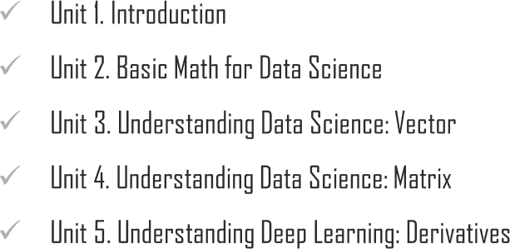
Chapter Description

Slide 4



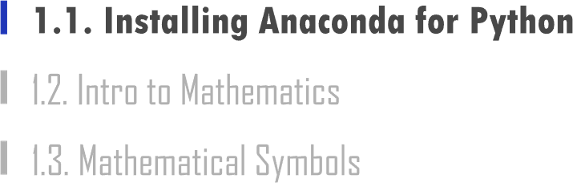

Slide 5


1.1. Installing Anaconda for Python
UNIT 01
1 Install Anaconda
2
Install
Tensorflow
Tensorflow
Keras
3
Install Keras
Pandas
Scipy
Jupyto
Numpy
Python

Slide 6



1.1. Installing Anaconda for Python
UNIT 01

Slide 7

1.1. Installing Anaconda for Python
UNIT 01

Slide 8


1.1. Installing Anaconda for Python
UNIT 01

Slide 9

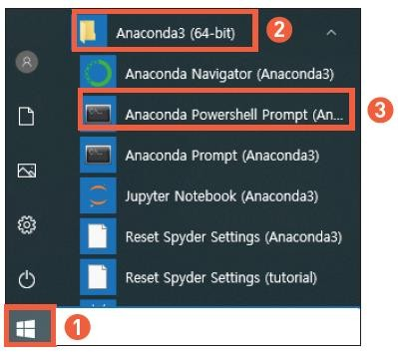
1.1. Installing Anaconda for Python
UNIT 01
2
3
1

Slide 10
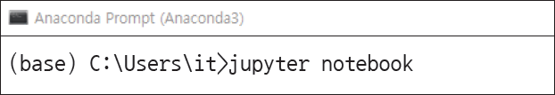
1.1. Installing Anaconda for Python
UNIT 01

Slide 11
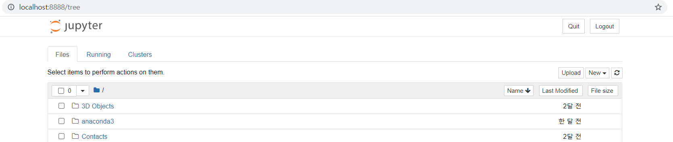
1.1. Installing Anaconda for Python
UNIT 01

Slide 12
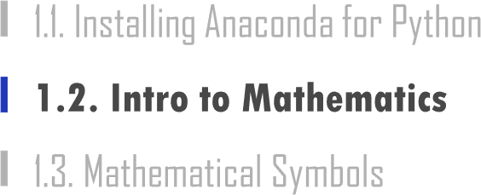

Slide 13
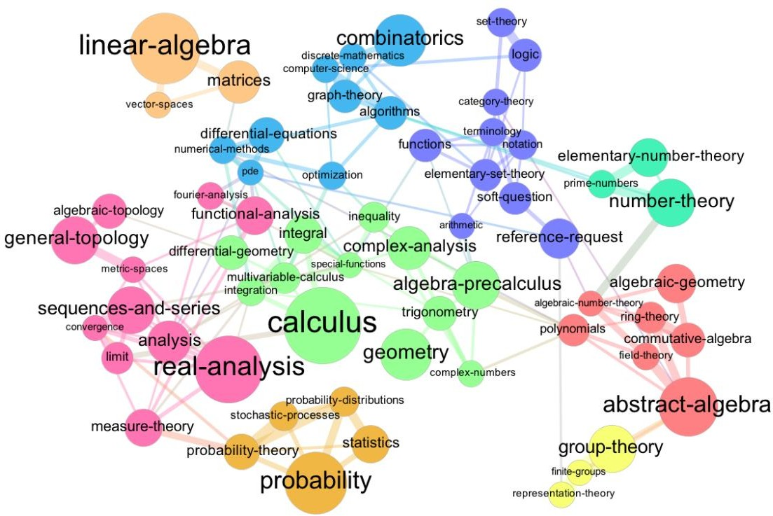
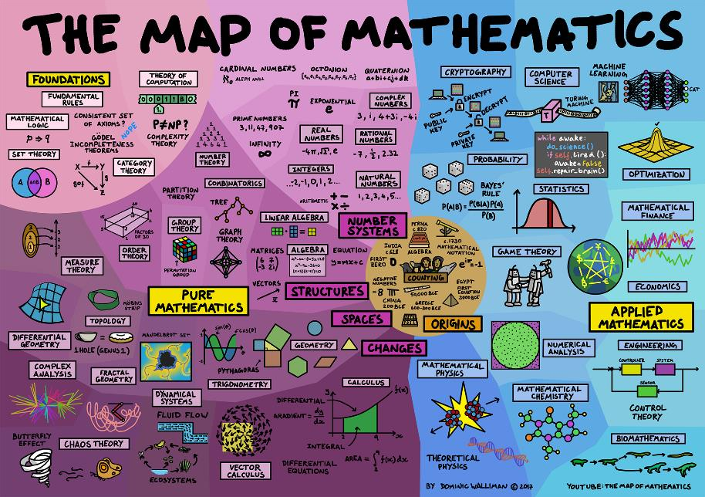
1.2. Intro to Mathematics
UNIT 01
https://www.quora.com/Is-there-any-diagram-or-tree-of-all-fields-of-mathematics-or-mathematics-evolution

Slide 14








1.2. Intro to Mathematics
UNIT 01
Real
A number represented on a line
Rational
A real number that can be written as
fractions
5 1
3 ⁻ 128
Irrational
A real number that is not rational
Integers
A whole number with a negative set of natural numbers (no fractions)
𝜋 = 3.1415 ⋯
𝑒=2.71828
2 = 1.4142 ⋯
−5 − 4 − 3 − 2 − 1 0
Natural Positive integer (excl. 0)
1 2 3 4 5

Slide 15
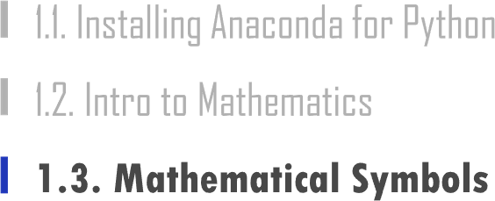

Slide 16








1.3. Mathematical Symbols
UNIT 01

Slide 17

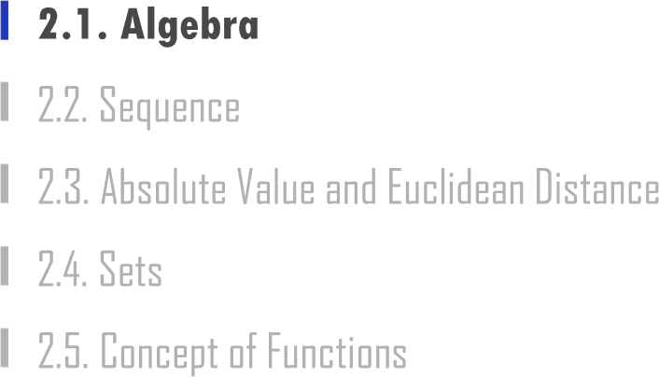
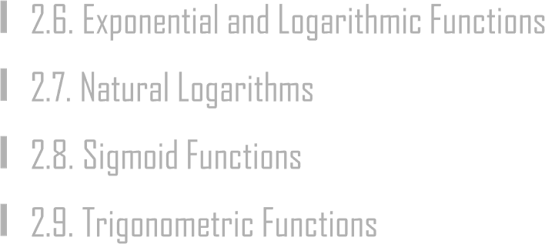

Slide 18



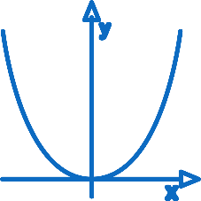
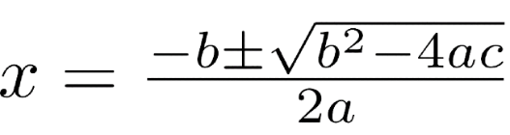
2.1. Algebra
UNIT 02
Algebra

Slide 19
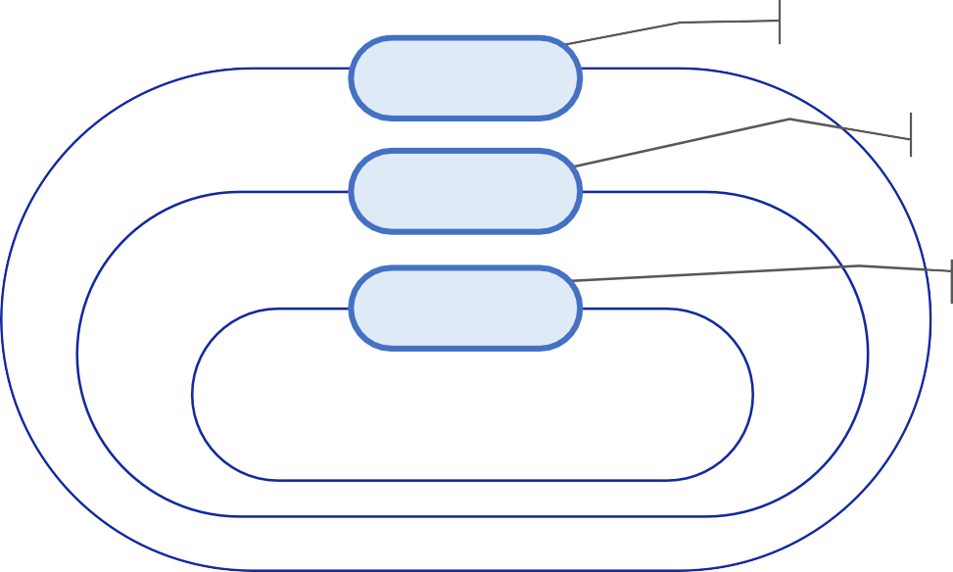
2.1. Algebra
UNIT 02
An expression with a “=“ sign
Equality
y
7
9-5
5 × 𝑥 − 9
4 + 8 × (5 – 4)
X + 5 × (7 – 𝑥)
𝐴 = 𝐵
Equations with Unknowns
Equation
X+1=3
Identity
An equation is established no matter what value is added to the unknown.
a+a=2a
Equality, Equation, Identity

Slide 20

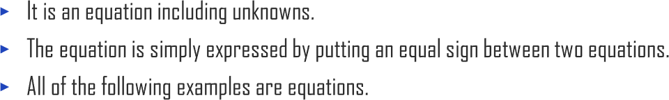
2.1. Algebra
UNIT 02
7=7
x=9 y+9=14
x-4=15−𝑥
5𝑥𝑦 = 8𝑥𝑦² + 4

Slide 21

2.1. Algebra
UNIT 02
Ex
In y=f(x), 𝑥 is an independent variable, and 𝑦 is a dependent variable.
n represents a natural number or integer.
x represents a real number.
z represents a complex number.

Slide 22
2.1. Algebra
UNIT 02
It is an expression of a number or letter or a product of the two. For example:
3, a, 3a, -4ab , ^{x}, a²
4
The number of times each term is multiplied by a variable is called a degree.
In each term, the part excluding the characters corresponding to the variables is called a coefficient.
The order of terms multiplied by two or more variables can be added to the indices of each variable.
Ex
If a term is x2y3, the order for the variables x and y is 2 + 3 = 5 which is 5.

Slide 23

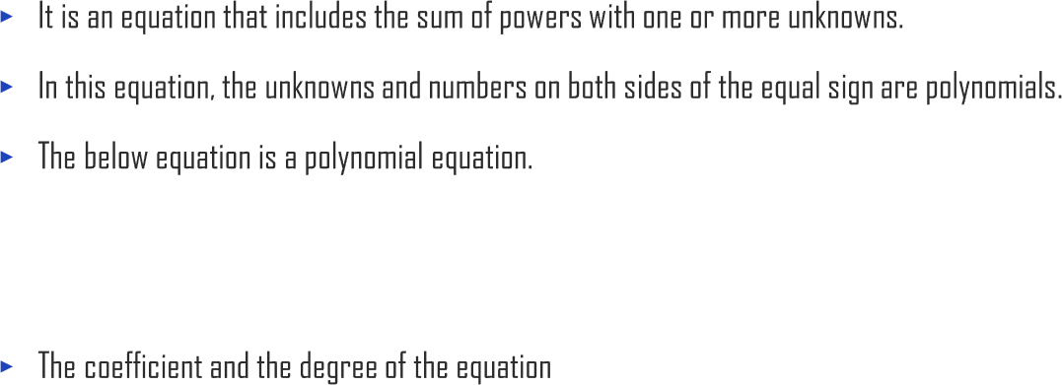
2.1. Algebra
UNIT 02
(𝑥 − 2)³ = 𝑥³ − 6𝑥² + 12𝑥 − 8
4 Terms
Coefficient | 4 -3 | 4 | 6
Degree | 1 1 | 3 | 0

Slide 24

2.1. Algebra
UNIT 02
Graph of a First-Degree Equation
First−Degree Equation for 𝑥, 𝑎𝑥 + 𝑏 (𝑏𝑢𝑡, 𝑎 ≠ 0) 𝑎 slope 𝑏 intercept | 𝑎 > 0 𝑏 0 | 𝑦 𝑎 intercept 1 𝑥 | 𝑎 < 0 | b 0 | 𝑦 1 intercept | 𝑎 | 𝑥
a and b are treated as constants.
The degree of term ax is 1, and the order of term b is zero because there is no letter x. Thus, this equation becomes a first-degree equation.

Slide 25

2.1. Algebra
UNIT 02
Graph of a Second-Degree Equation
Second-Degree Equation for 𝑥, 𝑎𝑥2 + 𝑏𝑥 + 𝑐 (𝑏𝑢𝑡 𝑎 ≠ 0) | 𝑎 > 0 _{𝑦} 0 _{c} Convex Downward | 𝑥 | 𝑎 < 0 𝑦 𝑐 0 Convex Upward | 𝑥
a and b are treated as constants. The degree of ax is 2, the degree of b is 1, and the degree of c is 0 because there is no letter x. Thus, this equation is a second- degree equation.

Slide 26
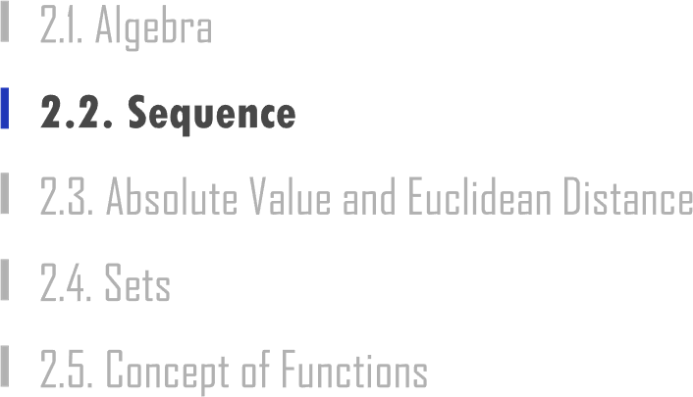

Slide 27


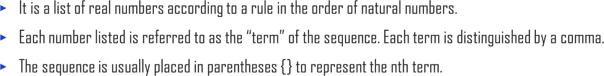
2.2. Sequence
UNIT 02
Ex
Example of a Sequence
1,2,3,4
𝑥₁, 𝑥₂, 𝑥₃, 𝑥₄
𝑥₁, 𝑥₂, ⋯ 𝑥_{𝑛}

Slide 28
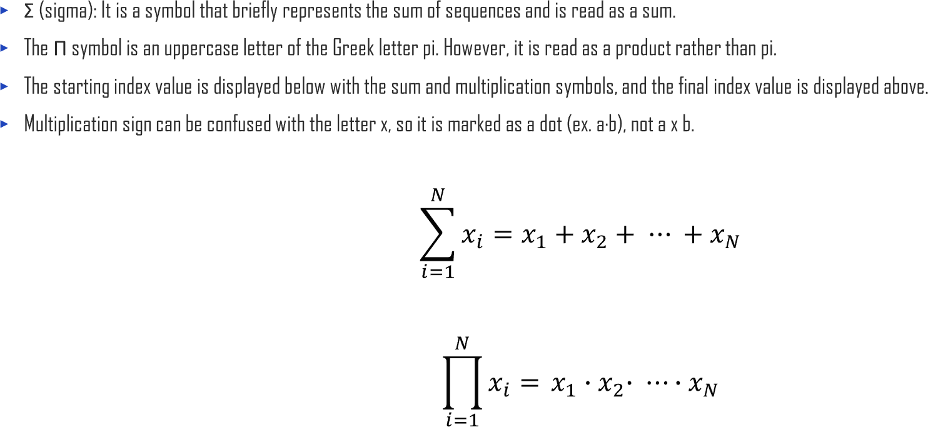
2.2. Sequence
UNIT 02

Slide 29

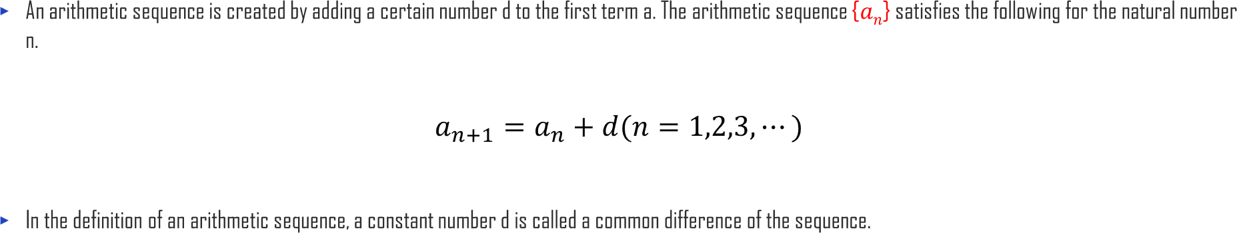
2.2. Sequence
UNIT 02

Slide 30

2.2. Sequence
UNIT 02

Slide 31
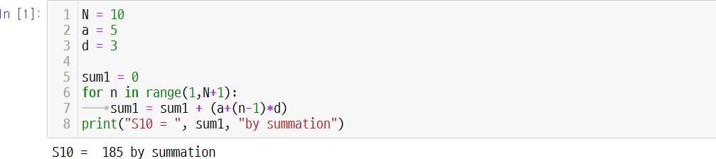
2.2. Sequence
UNIT 02

Slide 32

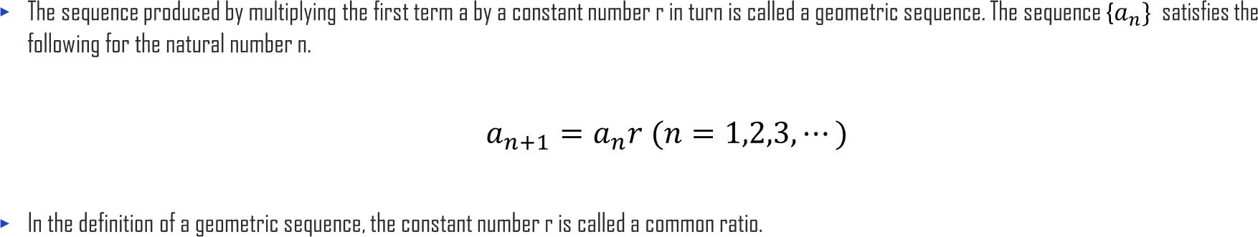
2.2. Sequence
UNIT 02

Slide 33
2.2. Sequence
UNIT 02
𝑛𝑎
, 𝑟 = 1
𝑆_{𝑛} = ቐ𝑎(1 − 𝑟^{𝑛})
=
1 − 𝑟
𝑎(𝑟^{𝑛} − 1)
𝑟 − 1
, 𝑟 ≠ 1

Slide 34

2.2. Sequence
UNIT 02
For sequences {𝑎_{𝑛}}, {𝑏_{𝑛}}, and constant 𝑐, the symbol Σ satisfies the following properties.
𝑛 𝑛 𝑛 𝑛
𝑛
𝑛
(1) ෍(𝑎_{𝑘} + 𝑏𝑘) = ෍ 𝑎_{𝑘} + ෍ 𝑏_{𝑘} |  |  |  | (2) ෍(𝑎_{𝑘} − 𝑏_{𝑘}) = ෍ 𝑎_{𝑘} − ෍ 𝑏_{𝑘}
𝑘=1 |  | 𝑘=1 | 𝑘=1 | 𝑘=1 | 𝑘=1 | 𝑘=1
𝑛 | 𝑛 |  |  | 𝑛
(3) ෍ 𝑐𝑎_{𝑘} = 𝑐 ෍ 𝑎_{𝑘} |  |  | (4) ෍ 𝑐 = 𝑐𝑛
𝑘=1 𝑘=1 |  |  | 𝑘=1

Slide 35
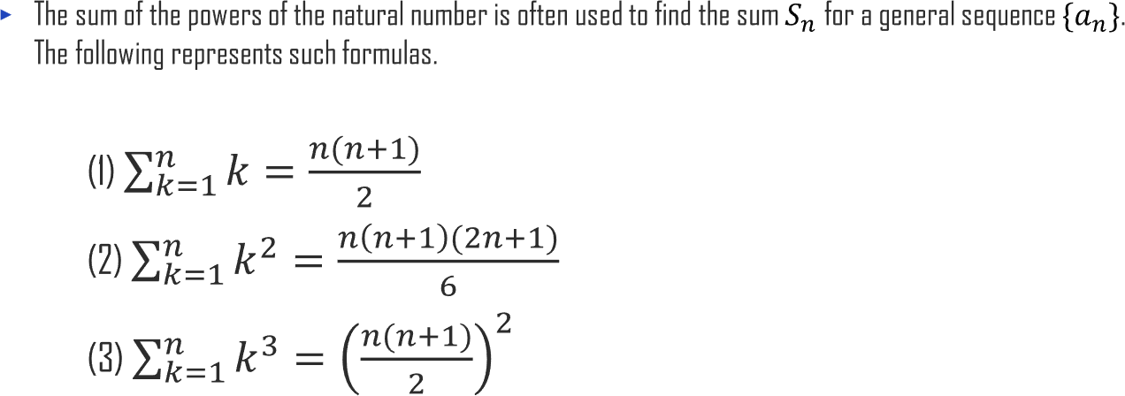
2.2. Sequence
UNIT 02

Slide 36
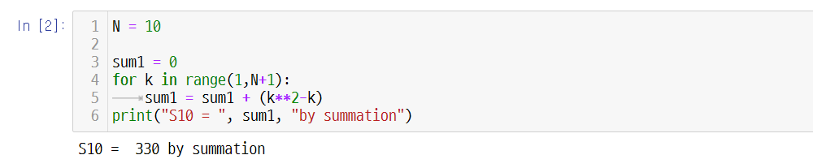
2.2. Sequence
UNIT 02
10
෍(𝑘²−𝑘)
𝑘=1

Slide 37
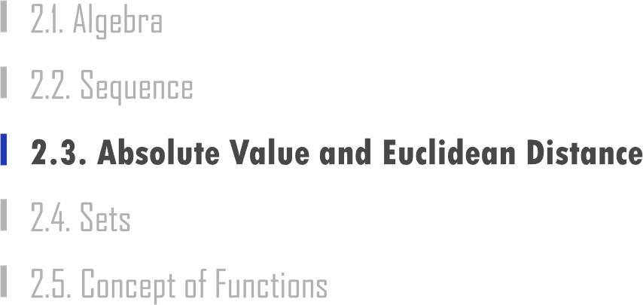

Slide 38
2.3. Absolute Value and Euclidean Distance
UNIT 02
Distance = 3
Distance = 3
-3
-2
-1
0
1
2
3
4

Slide 39
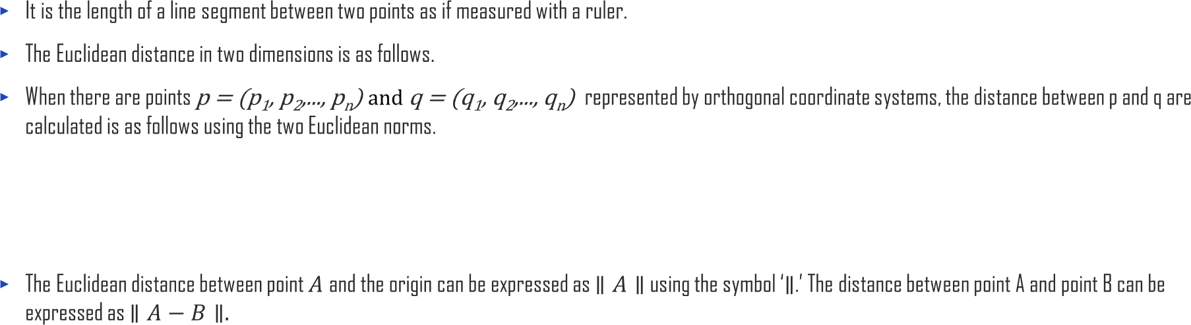
2.3. Absolute Value and Euclidean Distance
UNIT 02
∥ 𝑝 − 𝑞 ∥ =
𝑝 − 𝑞 ∙ 𝑝 − 𝑞 = ∥ 𝑝 ∥² +∥ 𝑞 ∥² − 2𝑝 ⋅ 𝑞

Slide 40

2.3. Absolute Value and Euclidean Distance
UNIT 02
y
The distance of segment AB
is the distance between point a₂
A and point B.
A(a₁, a₂)
A
b₂
(a₂− b₂)
B (b₁, b₂)
x
B
0
b₁ a₁
(a − b )
1 1

Slide 41
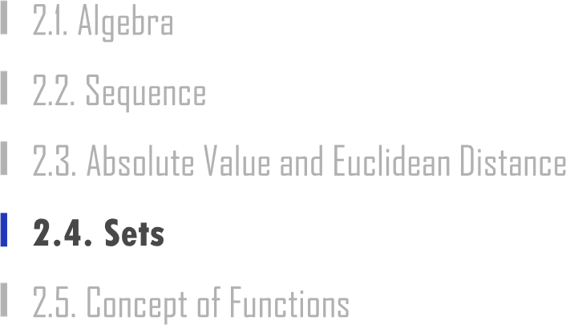

Slide 42

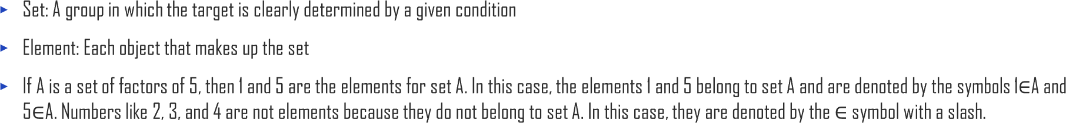

2.4. Sets
UNIT 02
Ex
{1, 2, 3}
Ex
{𝑥ȁ𝑥 is a multiple of 3}

Slide 43
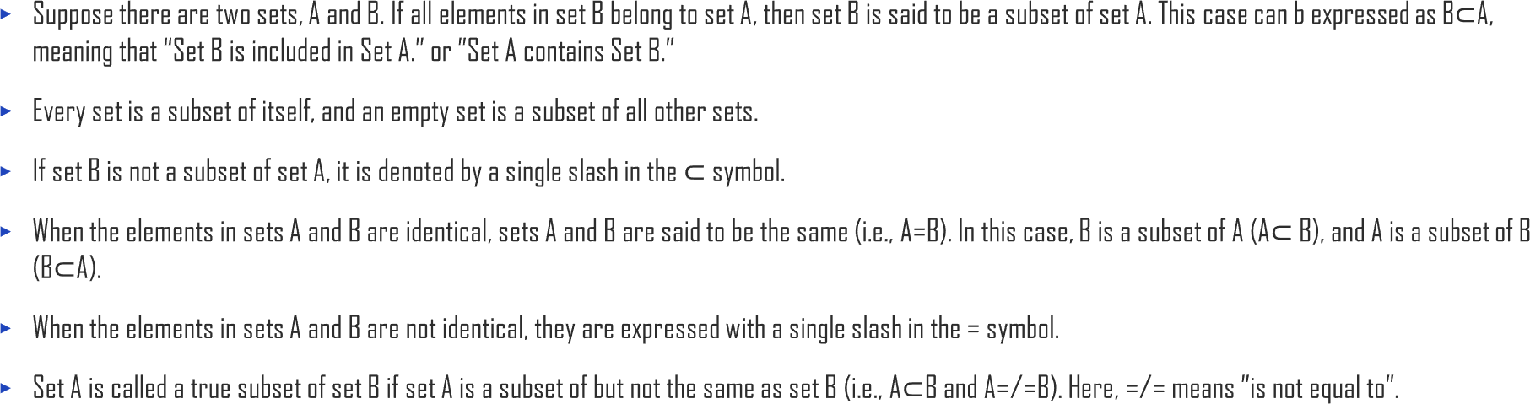
2.4. Sets
UNIT 02

Slide 44
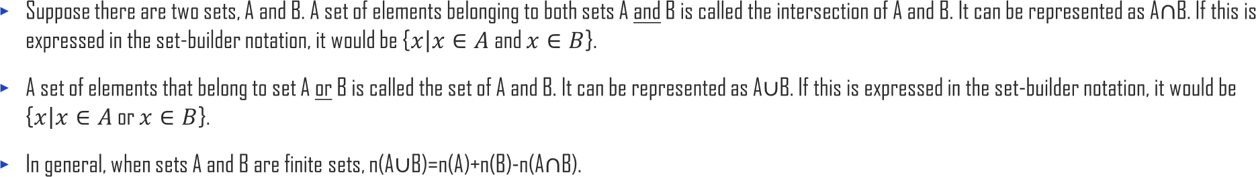
2.4. Sets
UNIT 02

Slide 45
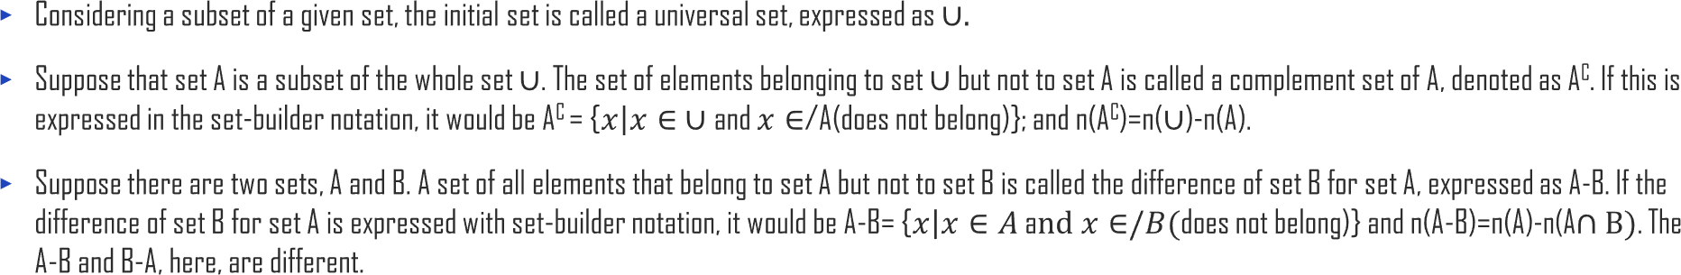
2.4. Sets
UNIT 02

Slide 46

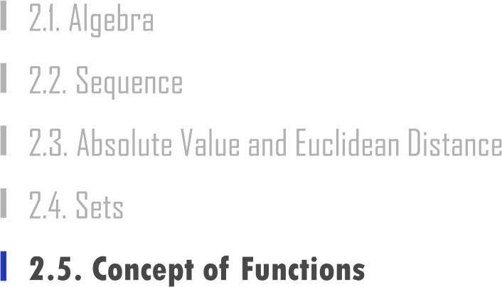

Slide 47

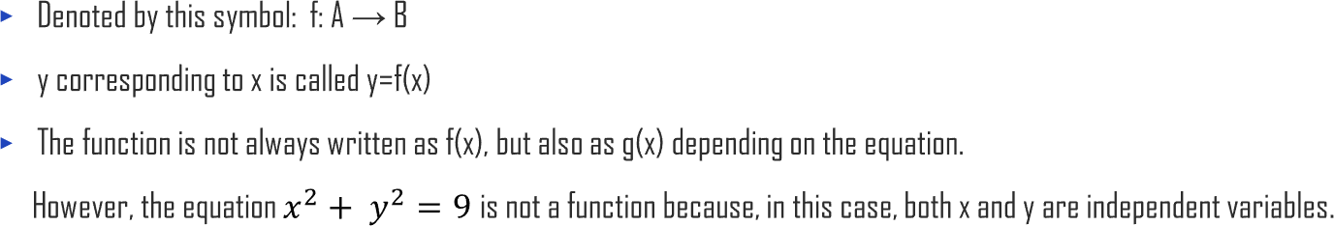
2.5. Concept of Functions
UNIT 02

Slide 48










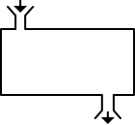



2.5. Concept of Functions
UNIT 02
Fruit (input) Mixer (function) Juice (output)

Slide 49
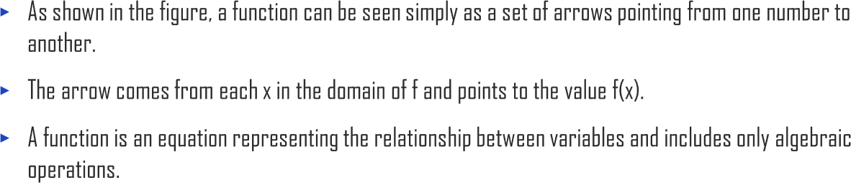
2.5. Concept of Functions
UNIT 02
𝑓(𝑑)
𝑓(𝑏)
a
b
𝑓(𝑎)
𝑓(𝑐)
c d x
𝑓(𝑥)

Slide 50

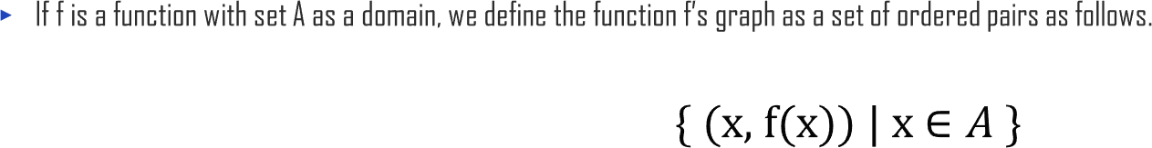
2.5. Concept of Functions
UNIT 02

Slide 51
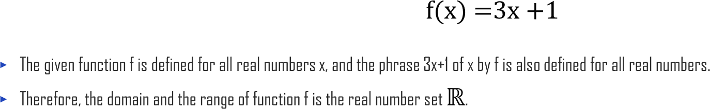
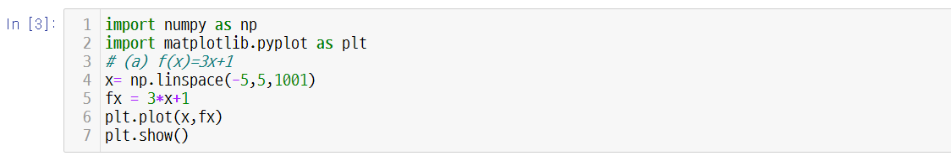
2.5. Concept of Functions
UNIT 02
𝑦
𝑓(𝑥) = 3𝑥 + 1
1
1
− ₃
0
𝑥

Slide 52
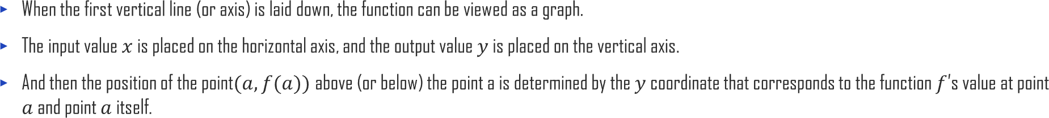
2.5. Concept of Functions
UNIT 02
G𝑟𝑎𝑝ℎ 𝑦 = 𝑓(𝑥) y
A(𝑎₁, 𝑎₂)
a
0
x
f(a)
(^{𝑎}, ^{𝑓}(^{𝑎}))

Slide 53
2.5. Concept of Functions
UNIT 02
𝐹(𝑥) = 𝑥 3 3 2 2 ₂ 1 1 1 0 0 -1 -1 ₋ ₋₁ ₁ ₂ -2 -2 ² ⁻¹ -3 -3 − 2 -4 -4 Arrows Graph | 𝑔(𝑥) = 2𝑥 ₃ 4 3 2 2 1 1 0 0 -1 ₋₁ -2 ₋₂ -3 ₋₃ -4 -4 Arrows Graph | ℎ(𝑥) = 𝑥² 4 4 3 3 ⁴ 2 2 ₃ 1 1 2 0 0 1 -1 -1 -2 -2 − −1 ₁ ₂ -3 -3 ² Arrows Graph

Slide 54




2.5. Concept of Functions
UNIT 02
Ex

Slide 55
2.5. Concept of Functions
UNIT 02
f(g(x)) =10 + 𝑔(𝑥)² = 10 + (3 + 𝑥)²
g(f(x)) = 3 +f(x) = 3 + (10+𝑥²)
𝑥
𝑓
𝑔
𝑔(𝑓(𝑥))
𝑓(𝑥)
ℎ ∶ 𝑥 → 𝑓(𝑥) → 𝑔(𝑓(𝑥))

Slide 56
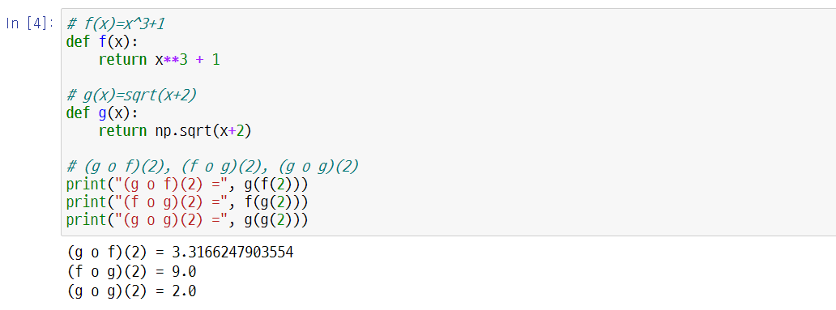
2.5. Concept of Functions
UNIT 02

Slide 57
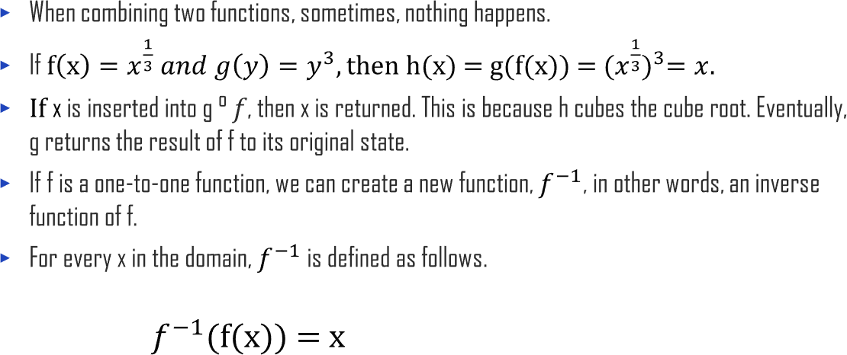
2.5. Concept of Functions
UNIT 02
𝑓⁻¹(a)
a
b
𝑓⁻¹(b)

Slide 58
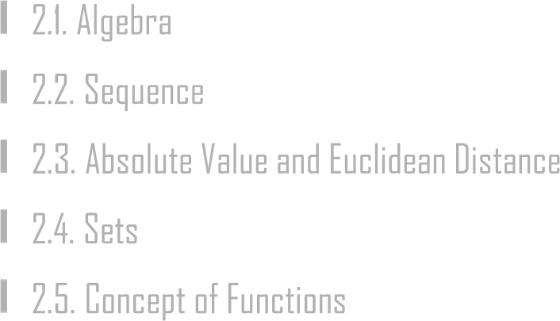
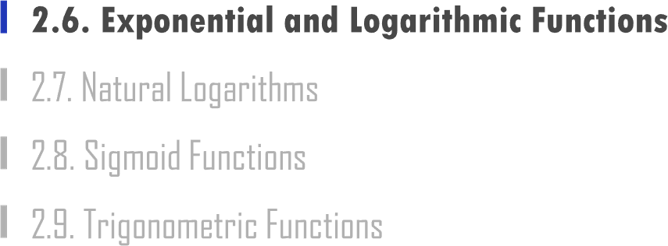

Slide 59

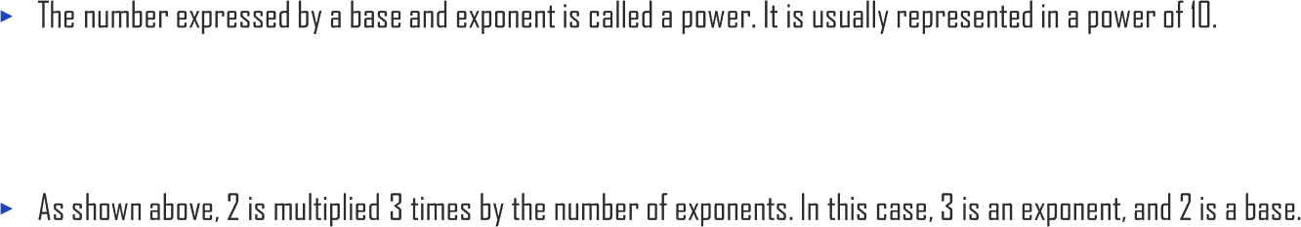
2.6. Exponential and Logarithmic Functions
UNIT 02
2³ = 2 ∙ 2 ∙ 2 = 8

Slide 60
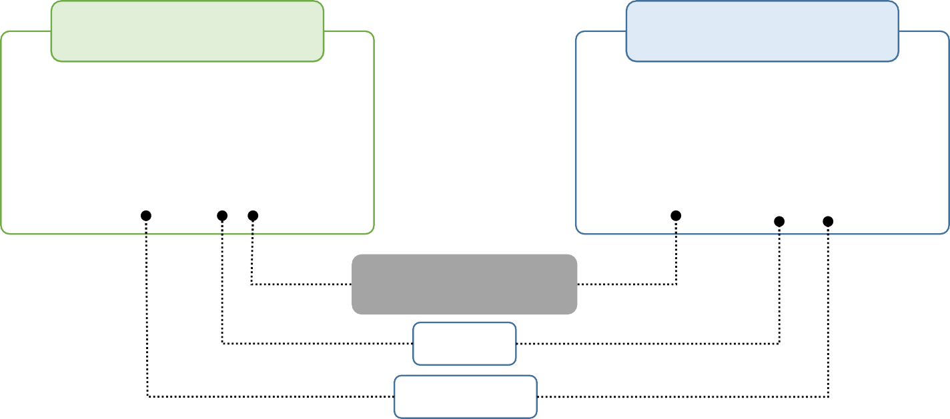
2.6. Exponential and Logarithmic Functions
UNIT 02
2³ = 2 ∙ 2 ∙ 2 = 8
Exponentials
Logarithms
8 = 2³
100 = 10²
81 = 3⁴
− ₂
0.01 = 10
3 = log₂ 8
2 = log₁₀ 100
4 = log₃ 81
−2 = log 0.01
10
Exponents Log
Base Antilog

Slide 61

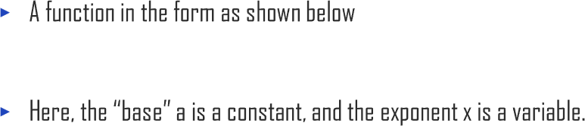
2.6. Exponential and Logarithmic Functions
UNIT 02
f(x) = 𝑎^{𝑥}
For the real number 𝑎, satisfying 𝑎 > 0, 𝑎 ≠ 1, the graph of the exponential function 𝑦 = 𝑎𝑥 with the range 𝑎 can be drawn as shown below.
y=a^{x} y=a^{x}
y y
a₁ 1
1
a₁
x
x
0
t
0
t
(a) When a >1 (b) When 0<a <1
The graph of the exponential function 𝒚 = 𝒂^{𝟐} with the range 𝒂

Slide 62
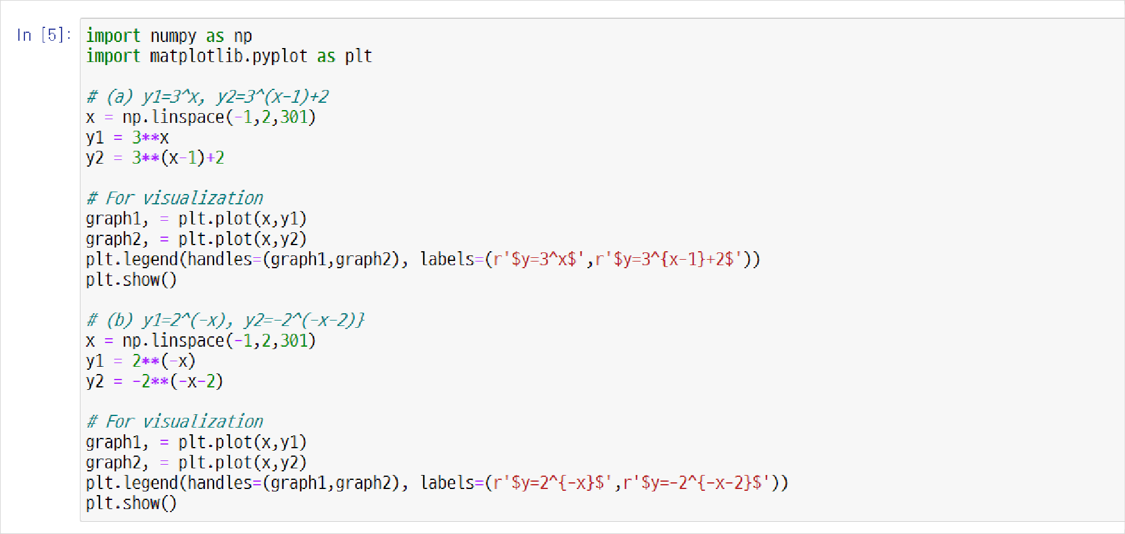
2.6. Exponential and Logarithmic Functions
UNIT 02
y2=2**(-x-2)
2^{-X-2}$

Slide 63
2.6. Exponential and Logarithmic Functions
UNIT 02
𝑦 = 3
𝑦 = 3^{𝑥-1} + 2
2.0
𝑦 = 2^{-𝑥}
_{𝑦 = −2}-x-2
8
1.5
1.0
0.5
0.0
-0.5
6
4
2
0
−1.0 -0.5 0.0 0.5
1.0 1.5 2.0
−1.0 -0.5 0.0 0.5
1.0 1.5 2.0

Slide 64


2.6. Exponential and Logarithmic Functions
UNIT 02
𝑓 𝑥 = 𝑙𝑜𝑔_{𝑎}𝑥
For the real number 𝑎, satisfying 𝑎 > 0, 𝑎 ≠ 1, the graph of the logarithmic function y = log_{a} x with the range 𝑎 can be drawn as shown below.
y y
𝑦 = 𝑎𝑥
𝑦 = 𝑥
𝑦 = 𝑥
𝑦 = 𝑎𝑥
𝑦 = log_{𝑎} 𝑥
1
(a) When a >1
1
(b) When 0<a <1
0
x
0
x
1
1
𝑦 = log_{𝑎} 𝑥
The Graph of the Logarithmic Function 𝒚 = 𝒍𝒐𝒈𝒂𝒙 with the range 𝒂

Slide 65
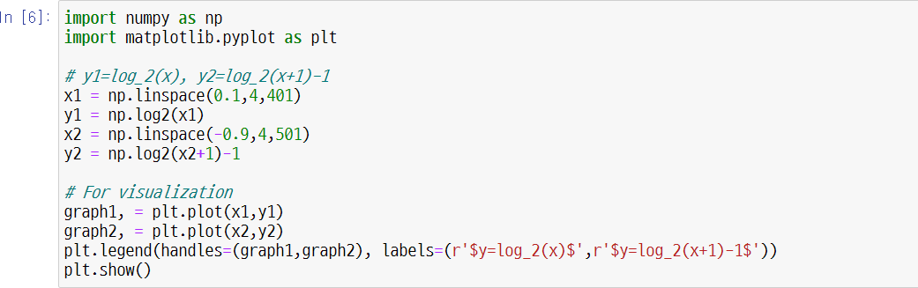
2.6. Exponential and Logarithmic Functions
UNIT 02

Slide 66
2.6. Exponential and Logarithmic Functions
UNIT 02
2
1
0
-1
-2
-3
-4
𝑦 = log₂(𝑥)
𝑦 = log_{𝑥} 𝑥 + 1 − 1
−1
0
1
2
3
4

Slide 67
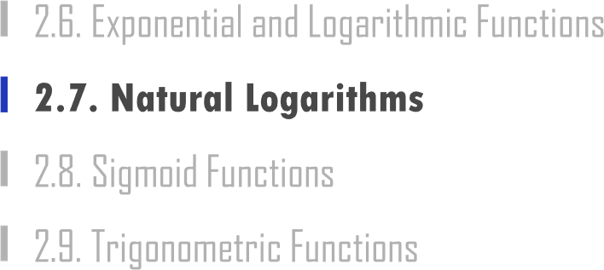

Slide 68
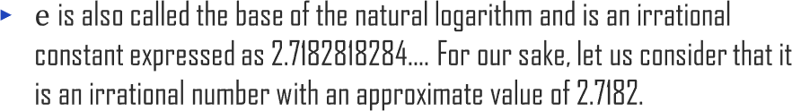

2.7. Natural Logarithms
UNIT 02
x | (1+x)^(1/x) |  | x | (1+x)^(1/x)
0.01 | 2.70481383 |  | 0.0001 | 2.71814593
0.0099 | 2.7049473 |  | 0.00009 | 2.7181595
0.0098 | 2.70508079 |  | 0.00008 | 2.71817311
0.0097 | 2.70521431 |  | 0.00007 | 2.71818669
0.0096 | 2.70534785 |  | 0.00006 | 2.71820028
0.0095 | 2.70548142 |  | 0.00005 | 2.71821387
0.0094 | 2.70561501 |  | 0.00004 | 2.71822746
0.0093 | 2.70574863 |  | 0.00003 | 2.71824106
0.0092 | 2.70588227 |  | 0.00002 | 2.71825465
0.0091 | 2.70601593 |  | 0.00001 | 2.71826824
0.009 | 2.70614962 |  | 0 | #DIV/0!
0.0089 | 2.70628333 |  | -1.E-05 | 2.71829542
0.0088 | 2.70641707 |  | -2.E-05 | 2.71830901
0.0087 | 2.70655083 |  | -3.E-05 | 2.71832260
0.0086 | 2.70668461 |  | -4.E-05 | 2.71833620
0.0085 | 2.70681842 |  | -5.E-05 | 2.71834979
0.0084 | 2.70695225 |  | -6.E-05 | 2.71836338
0.0083 | 2.70708611 |  | -7.E-05 | 2.71837697
0.0082 | 2.70722 |  | -8.E-05 | 2.71839057
0.0081 | 2.70735390 |  | -9.E-05 | 2.71840416
0.008 | 2.70748783 |  | -0.0001 | 2.71841776
0.0079 | 2.70762179 |  | -0.0001 | 2.71843135
0.0078 | 2.70775577 |  | -0.0001 | 2.71844494
0.0077 | 2.70788977 |  | -0.0001 | 2.71845854
0.0076 | 2.70802380 |  | -0.0001 | 2.71847213
0.0075 | 2.70815785 |  | -0.0002 | 2.71848573
0.0074 | 2.70829193 |  | -0.0002 | 2.71849932
0.0073 | 2.70842603 |  | -0.0002 | 2.71851292
0.0072 | 2.70856016 |  | -0.0002 | 2.71852651

Slide 69

2.7. Natural Logarithms
UNIT 02

Slide 70
2.7. Natural Logarithms
UNIT 02

Slide 71

2.7. Natural Logarithms
UNIT 02

Slide 72


Slide 73


2.8. Sigmoid Functions
UNIT 02
 |  | 1
 |  | 0.5 0
Logistic Curve
-6 -4 -2 0 2 4 6

Slide 74
2.8. Sigmoid Functions
UNIT 02
1
1 + exp(−𝑎𝑥)
x | y
-1 | 3.72008E-44
-0.9 | 8.19401E-40
-0.8 | 1.80485E-35
-0.7 | 3.97545E-31
-0.6 | 8.75651E-27
-0.5 | 1.92875E-22
-0.4 | 4.24835E-18
-0.3 | 9.35762E-14
-0.2 | 2.06115E-09
-0.1 | 4.53979E-05
0 | 0.5
0.1 | 0.999954602
0.2 | 0.999999998
0.3 | 1
0.4 | 1
0.5 | 1
0.6 | 1
0.7 | 1
0.8 | 1
0.9 | 1
1 | 1
Sigmoid Function Graph
1.2
1
0.8
0.6
0.4
0.2
0
-1.5
-1
-0.5
0
0.5
1
1.5

Slide 75


Slide 76
2.9. Trigonometric Functions
UNIT 02
𝑦
𝑥
𝑦
tan 𝜃 =
𝑥
Definition of a Trigonometric Function
−𝑟 | 𝑦 0 | 𝑦 +𝑟 𝑟 𝜃 −𝑟 | 𝑥 | (𝑥, 𝑦) 𝑥 +𝑟
sin 𝜃 = ,
cos 𝜃 = ,
𝑟
𝑟
𝑟
𝑟
𝑥
cot 𝜃 =
𝑦
csc 𝜃 = ,
sec 𝜃 = ,
𝑦
𝑥

Slide 77


2.9. Trigonometric Functions
UNIT 02
3
2
0.866
2
2
0.707
1
₂ 0.5
1
− 0.5
2
2
− ₂ −0.707
3
− ₂ −0.866
3
0.866
2
2
2
0.707 ₁
₂ 0.5
1
2
2
− 0.5
− ₂ −0.707
3
− ₂ −0.866

Slide 78



Slide 79




3.1. Vector
UNIT 03
Linear Relationship between Time and Height of Water

Slide 80



3.1. Vector
UNIT 03

Slide 81

3.1. Vector
UNIT 03
𝑄
𝑣
𝑃𝑄 = ⁵ 𝑜𝑟 𝑣 = ⁵
3 3
𝑃𝑄
𝑃

Slide 82

3.1. Vector
UNIT 03
 |  |  | 𝑷
 |  | 𝑣
 |  | O |  | 𝑥
𝑣 = ⁵
3

Slide 83


Slide 84


3.2. Vector Norm
UNIT 03

Slide 85


Slide 86

3.3. Inner Product
UNIT 03
𝑏 = (2,3)
𝑎 = (3,1)
The result of the vector’s inner product is in a form of a real number (size) rather than in a form of a vector.
This real number is sometimes referred to as scalar, and so this process is often called the scalar multiplication.
The operator symbol of the inner product is not x, but ∙, and it is called a “dot.”

Slide 87

3.3. Inner Product
UNIT 03
𝑏 = (2,3)
𝜃
𝑎 = (3,1)

Slide 88


Slide 89


3.4. Orthogonal Condition
UNIT 03
b
a

Slide 90


Slide 91

3.5. Normal Vector
UNIT 03
Normal Vector p
90 °

Slide 92


Slide 93


3.6. Cosine Similarity
UNIT 03
a(-4, -2)
b(6, 3)
a(4, 2)
b(6, 3)
a(6, 3)
b(1, -2)
Cosine Similarity is -1.
Cosine Similarity is 0.
Cosine Similarity is 1.

Slide 94



Slide 95


4.1. Calculating Matrix
UNIT 04
Ex
5.1 3.5 1.4 0.2
4.9 3.0 1.4 0.2
4.7 3.2 1.3 0.2
4.6 3.1 1.5 0.2
⋮ ⋮ ⋮ ⋮ 6.2 3.4 5.4 2.3
5.9 3.0 5.1 1.8
^{𝑥}1,1
^{𝑥}2,1
^{𝑥}3,1
^{𝑥}4,1
⋮
^{𝑥}149,1
^{𝑥}1,2 ^{𝑥}1,3
^{𝑥}2,2 ^{𝑥}2,3
^{𝑥}3,2 ^{𝑥}3,3
^{𝑥}4,2 ^{𝑥}4,3
⋮ ⋮
^{𝑥}149,2 ^{𝑥}149,3
^{𝑥}1,4
^{𝑥}2,4
^{𝑥}3,4
^{𝑥}4,4
⋮
^{𝑥}149,4
row
𝑋 =
=
^{𝑥}150 1
^{𝑥}150 2 ^{𝑥}150 3
^{𝑥}150 4
,
, ,
,
column

Slide 96

4.1. Calculating Matrix
UNIT 04
^{𝑎}11 ^{𝑎}12
^{𝑎}21 ^{𝑎}22
⋮ ⋮
^{𝑎}𝑛1 ^{𝑎}𝑛2
⋯
⋯
⋱
⋯
^{𝑎}1𝑚
^{𝑎}2𝑚
⋮
^{𝑎}𝑛𝑚
^{𝑎}11 ^{𝑎}21
^{𝑎}12 ^{𝑎}22
⋮ ⋮
^{𝑎}1𝑚 ^{𝑎}2𝑚
⋯
⋯
⋱
⋯
^{𝑎}𝑛1
^{𝑎}𝑛2
⋮
^{𝑎}𝑛𝑚
𝐴 =
,
𝐴^{𝑇} =

Slide 97

4.1. Calculating Matrix
UNIT 04
Ex
𝑓 𝑥 = 𝑓 𝑥1, 𝑥2, 𝑥3
= 2𝑥₁𝑥₁ − 4𝑥₁𝑥₂ + 3𝑥₁𝑥₃ + 𝑥₂𝑥₁ + 2𝑥₂𝑥₂ + 6𝑥₂𝑥₃ − 2𝑥₃𝑥₁ + 3𝑥₃𝑥₂ + 2𝑥₁ + 3𝑥₂ − 4𝑥₃ + 5

Slide 98

4.1. Calculating Matrix
UNIT 04
2 0 1 50 0 0
Square Matrix 1 21 5 , Diagonal Matrix 0 1 0
4 5 12 0 0 8
,
1 0 0 1 2 11
Unit Matrix 0 1 0 , Symmetric Matrix 2 21 5
0 0 1 11 5 1

Slide 99

4.1. Calculating Matrix
UNIT 04
When 𝐶 = 𝐴𝐵, 𝑐_{𝑖𝑗} = ^{෍ 𝑎}𝑗𝑘^{𝑏}𝑘𝑗
𝑘=1,𝑠
If a 2 ∗ 3 Matrix 𝐴 =
3
0
⁴ ¹ is multiplied by Matrix ² ⁰ ⁰ ,
₅ ₂ 3 ∗ 3 𝐵 = 1 0 5
4 5 0
2 ∗ 3 Matrix 𝐶 = 𝐴𝐵 =
14 5 24 .
13 10 27

Slide 100

4.1. Calculating Matrix
UNIT 04
𝐴 =
1
−4 1
⁻⁴ , 𝐵 =
1 −8
−8 2

Slide 101

4.1. Calculating Matrix
UNIT 04
₁ −1 2
₁ 4 −2
3 6
𝐴𝐵 = ² ³
4 5

Slide 102


Slide 103


4.2. Reverse Matrix
UNIT 04
1 0 0
𝐼 = 0 1 0
0 0 1
𝐼₃
1 0 0 ^{𝑥}1 ^{𝑥}1
0 1 0 𝑥₂ 𝑥₂
0 0 1 𝑥₃ 𝑥₃
=
1 | 0 | 0 |  | 𝑎 | 𝑏 | 𝑐 |  | 𝑎 | 𝑏 | 𝑐
0 | 1 | 0 |  | 𝑑 | 𝑒 | 𝑓 | = | 𝑑 | 𝑒 | 𝑓
0 | 0 | 1 |  | 𝑔 | ℎ | 𝑖 |  | 𝑔 | ℎ | 𝑖

Slide 104




4.2. Reverse Matrix
UNIT 04
2 1
1 2
∗
3 ∗
𝟐
𝟏
𝟓
𝟒
2
1 2
¹ -1*
2 1 ₌ 1 0
1 2 0 1
𝟐
𝟔
𝟑⁻¹∗ 𝟑 = 𝟏
= 𝐼
2 1
1 2
-1
₃-1∗
𝑨⁻¹𝑨 = 𝑨𝑨⁻¹= 𝑰
_{𝐴}-1₌
1
𝑎𝑑−𝑏𝑐
𝑑 −𝑏
−𝑐 𝑎
The Reverse Matrix of
2 1
6 4
𝑖𝑠
2 −0.5
−3 1

Slide 105

4.2. Reverse Matrix
UNIT 04

Slide 106
4.2. Reverse Matrix
UNIT 04
For the Matrix 𝐴 =
𝑎 𝑏
𝑐 𝑑
det
𝑎 𝑏
_{𝑐 𝑑} = 𝑎𝑑 − 𝑏𝑐
𝑎 𝑏
𝑐 𝑑
•
= 𝑎𝑑 − 𝑏𝑐
•
_{𝐴 =} 𝑎 𝑏
c 𝑑
= 𝑎𝑑 − 𝑏𝑐
𝑎𝑏
𝑐 d
_{= ቊ}𝑎𝑑 − 𝑏𝑐
𝑎𝑑 − 𝑏𝑐 > 0
𝑎𝑑 − 𝑏𝑐 < 0
𝐴 =
= 𝑎𝑑 − 𝑏𝑐
− 𝑎𝑑 − 𝑏𝑐

Slide 107

4.2. Reverse Matrix
UNIT 04
𝐴 =
1
5 7
³ , 𝐵 =
4 −6
−8 12

Slide 108


Slide 109
4.3. Linear Transformation
UNIT 04
Transformation 𝑇: When 𝑥’, 𝑦’ in (x, y) → (x’, y’) is expressed as follows, it is called linear transformation.
𝑥′ = 𝑎𝑥 + 𝑏𝑦
ቊ_{𝑦′ = 𝑐𝑥 + 𝑑𝑦} (𝑏𝑢𝑡, a, b, c, d are constants)

Slide 110
4.3. Linear Transformation
𝑥′ = 𝑎𝑥 + 𝑏𝑦 ^{ቊ}𝑦′ = 𝑐𝑥 + 𝑑𝑦
𝑥′ 𝑎
𝑦′ ⁼ 𝑐
𝑏
𝑑
𝑥
𝑦
𝑦
When performing linear transformation, the vector 𝑏𝑖 can be rotated, enlarged, or reduced using various matrices.
𝑏₁
0
𝑥

Slide 111


Slide 112

4.4. Eigenvalues and Eigenvectors
UNIT 04

Slide 113

4.4. Eigenvalues and Eigenvectors
UNIT 04

Slide 114
4.4. Eigenvalues and Eigenvectors
UNIT 04
𝐴𝑥 = 𝜆𝑥 (𝑏𝑢𝑡, 𝑥 ≠ 0)

Slide 115

4.4. Eigenvalues and Eigenvectors
UNIT 04

Slide 116

4.4. Eigenvalues and Eigenvectors
UNIT 04
𝐴𝑥 = 𝜆𝑥 (𝑏𝑢𝑡, 𝑥 ≠ 0)
(𝐴 − 𝜆𝐸)𝑥 = 0
(A − 𝜆E)⁻¹(A − 𝜆E)x=(A − 𝜆E)⁻¹0
det(A − 𝜆E) = 0

Slide 117

4.4. Eigenvalues and Eigenvectors
UNIT 04

Slide 118

4.4. Eigenvalues and Eigenvectors
UNIT 04

Slide 119

4.4. Eigenvalues and Eigenvectors
UNIT 04

Slide 120

4.4. Eigenvalues and Eigenvectors
UNIT 04

Slide 121

4.4. Eigenvalues and Eigenvectors
UNIT 04

Slide 122




Slide 123




5.1. Limits
UNIT 05
𝑦 = 𝑓(𝑥)
1
lim 𝑓 𝑥 = 𝛼
𝑥→𝛼
𝒇(𝒙) → 𝑎(𝒙 →a) 𝑎 is the limit.
𝑥² − 1
= lim(𝑥 + 1) = 2
𝑥→1
lim
𝑥→1 𝑥 − 1

Slide 124


Slide 125



5.2. Differential Coefficient and Derivatives
UNIT 05
∆𝑦 𝑓 𝑎 + ∆𝑥 − 𝑓(𝑎)
∆𝑥 ⁼ 𝑎 + ∆𝑥 − 𝑎
𝑓 𝑎 + ∆𝑥 − 𝑓(𝑎)
⁼ ∆𝑥

Slide 126


5.2. Differential Coefficient and Derivatives
UNIT 05
𝑓′ 𝑎 =
𝑓 𝑎 + ∆𝑥 − 𝑓(𝑎) 𝑓 𝑎 + ℎ lim = lim
− 𝑓(𝑎)
∆𝑥→0
∆𝑥 ℎ
ℎ→0

Slide 127


5.2. Differential Coefficient and Derivatives
UNIT 05
𝑦
Slope ∶
𝑓 𝑎 + ∆𝑥 − 𝑓(𝑎)
∆𝑥
𝑦 = 𝑓(𝑥)
(𝑎 + ∆𝑥, 𝑓(𝑎 + ∆𝑥))
(𝑎, 𝑓 𝑎 )
Slope of the Tangent: 𝑓’(𝑎)
O
𝑎
∆𝑥
𝑎 + ∆𝑥
𝑥

Slide 128

5.2. Differential Coefficient and Derivatives
UNIT 05

Slide 129


Slide 130

5.3. Differential Method
UNIT 05

Slide 131

5.3. Differential Method
UNIT 05

Slide 132

5.3. Differential Method
UNIT 05
# Use the letter x as a symbol

Slide 133


5.3. Differential Method
UNIT 05

Slide 134


Slide 135

5.4. Difference Between Logarithmic and Exponential
UNIT 05

Slide 136



5.4. Difference Between Logarithmic and Exponential
UNIT 05
(𝑏𝑢𝑡 x ≠ 0)

Slide 137


5.4. Difference Between Logarithmic and Exponential
UNIT 05

Slide 138



Slide 139

5.5. Derivatives of Composite Functions
UNIT 05
f(x)=10 + 𝑥²
g(x) = 3 + x
f(g(x)) =10 + 𝑔(𝑥)² = 10 + (3 + 𝑥)²
y =f(u)
u =g(x)
𝑑𝑦 𝑑𝑦 𝑑𝜇
=
𝑑𝑥 𝑑𝜇 𝑑𝑥
∙

Slide 140

5.5. Derivatives of Composite Functions
UNIT 05
𝑑𝑦 ₌ 𝑑
𝑑𝜇 𝑑𝜇
f(𝜇)
𝑑
= (10 + 𝜇²) = 2𝜇
𝑑𝜇
𝑑𝜇 𝑑
=
𝑔(𝑥)
𝑑𝑥 𝑑𝑥
𝑑
𝑑𝑥
3 + 𝑥 = 1
=

Slide 141

5.5. Derivatives of Composite Functions
UNIT 05
𝑓 𝑔 𝑥
′
= 𝑓′ 𝑔 𝑥
_{𝑔}′
𝑥

Slide 142


5.5. Derivatives of Composite Functions
UNIT 05
𝑓′(𝑥) = {𝑓(𝜇)}’ = 𝑓′(𝜇) ∙ 𝑢′ = 3 𝑢² ∙ (2 𝑥) = 6(𝑥² + 2)²

Slide 143


5.5. Derivatives of Composite Functions
UNIT 05
2
8𝑥
3
𝑔′(𝑥) = {g(𝜇)}’ = g′(𝜇) ∙ 𝑢′ = - ∙ 4 𝑥³ = -
_{𝑢}3
(𝑥⁴+1)³

Slide 144


Slide 145

5.6. High Order Derivatives and Partial Derivatives
UNIT 05
𝑦
𝑦
𝑦
𝑥
𝑥
𝑥
𝑥
𝑥
𝑥

Slide 146

5.6. High Order Derivatives and Partial Derivatives
UNIT 05
𝑦
𝑦
𝑦
𝑥
𝑥
𝑥
𝑥
𝑥
𝑥
𝜕𝑓(𝑥, 𝑦)
𝜕𝑥
∆𝑧
= lim _{∆𝑥} = lim 6𝑥 + 2𝑦 + 3∆𝑥 = 6𝑥 + 2𝑦
∆𝑥→0 ∆𝑥→0
𝜕𝑓(𝑥, 𝑦)
_{𝜕𝑦} = 2𝑥 + 4𝑦

Slide 147


Slide 148

5.7. Derivative of the Sigmoid Function
UNIT 05

Slide 149

5.7. Derivative of the Sigmoid Function
UNIT 05
When 𝜎(x) =
1
1+𝑒
−_{𝑥}
𝑑
𝑑𝑥
𝑑
𝑑𝑥 1+𝑒 ^{𝑥}
𝜎(x) =
1
−
₌ 𝑑
(1+e^{-x})⁻¹
𝑑𝑥
=−(1+e^{-x})⁻²(−e^{-x})
−
=
_{𝑒} 𝑥
(1+e^{−x})²
₌ 1 ∙
−
_{𝑒} 𝑥
1+e^{−x} 1+e^{−x}
−
𝑥
₌ 1 (1+𝑒 )−1
1+e^{−x ∙} 1+e^{−x}
1
1+e^{−x} 1+e^{−x}
=
1
(1 − )
= 𝜎(x) ∙ (1 − 𝜎(x) )

Slide 150



Slide 151


